Slide 1
Neural Networks
Neural networks

Slide 2
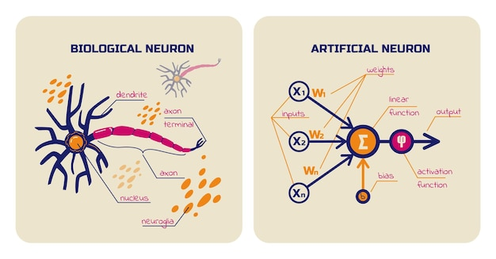

Slide 3
Plan
Learning from Examples
Supervised learning
Linear regression
Logistic regression
Binomial classification
Neural Networks
Convolutional Neural Networks
Transfer learning

Slide 4
Plan
Learning from Examples
Unsupervised learning
Recommendation systems
Possible AI systems
Predictive systems
Virtual assistants
Recommendation systems
Image (face) recognition systems

Slide 5
Neural networks
Last time we looked at some techniques that machines can use to learn patterns in that data that can be used to predict new data.
We will be looking at neural networks today. This technique is one of the most popular techniques in modern machine learning.
It was inspired by research on the human brain as far back as the 1940s.

Slide 6
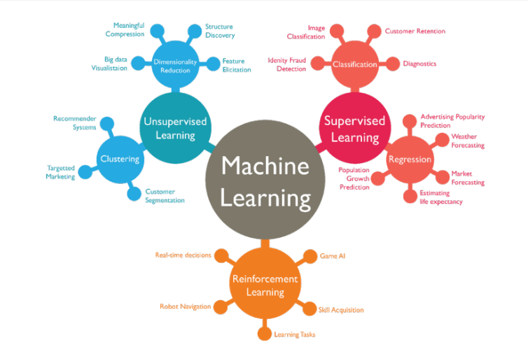

Slide 7
Supervised learning
Regression and classification, Linear models, other algorithms, Neural networks

Slide 8
Supervised Learning
In supervised learning, we are given a data set and already know what out correct output should look like.
We use a set of variables (or features), denoted as X, to predict an outcome, Y.
Supervised learning problems are classified into “regression” and “classification” problems

Slide 9
Regression vs Classification
In a regression problem, we are trying to predict results within a continuous output.
Example: predicting the price of a house given its dimension. The price has a continuous range of values.
In a classification problem, we are instead trying to predict results in a discrete output.
Example: predicting the type of breast cancer (malignant or benign) given the tumor size

Slide 10
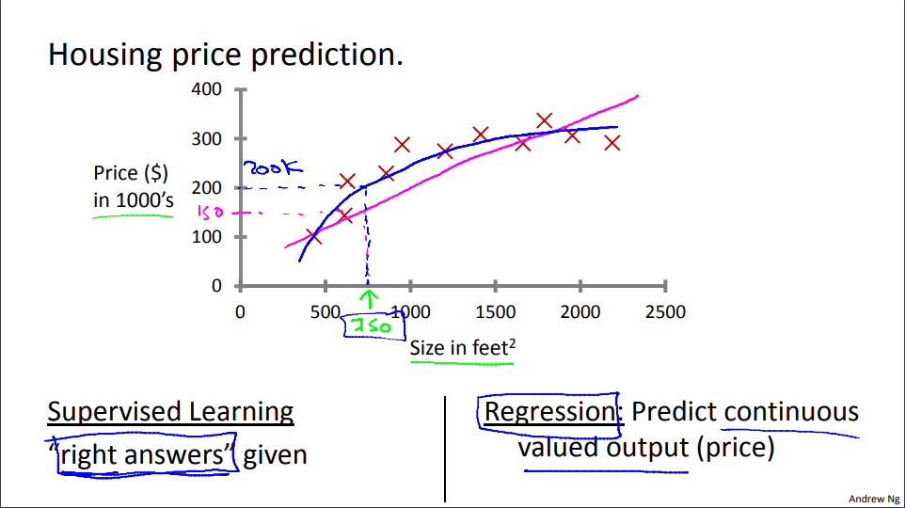

Slide 11
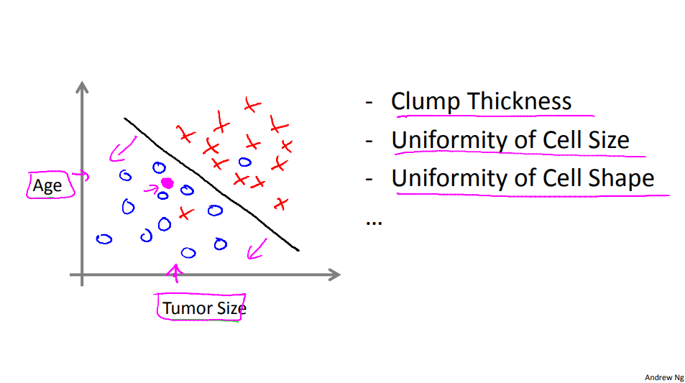

Slide 12
Supervised learning – Refresher
You’re running a company, and you want to develop learning algorithms to address each of two problems.
Problem 1: You have a large inventory of identical items. You want to predict how many of these items will sell over the next 3 months.
Problem 2: You’d like software to examine individual customer accounts, and for each account decide if it has been hacked/compromised.
Should you treat these as classification or as regression problems?

Slide 13
Supervised learning – Linear Regression
The goal of linear regression is to “fit” a linear equation to a data set.
Fitting the linear equation is finding the parameters of a linear equation that best models the relationship between the features and the outputs.

Slide 14
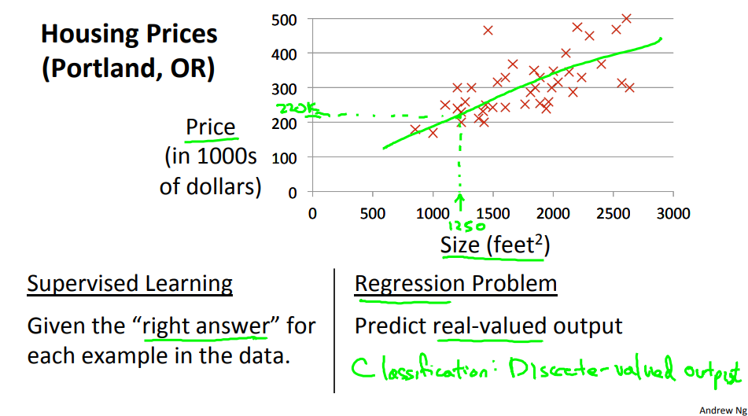
Supervised learning – Linear Regression

Slide 15
Logistic Regression
Logistic regression is used for classification problems.
It provides a hypothesis function (the sigmoid or logistic function) that outputs values between 0 and 1.
The hypothesis output is the estimated probability that y is equal to 1 for a given input

Slide 16
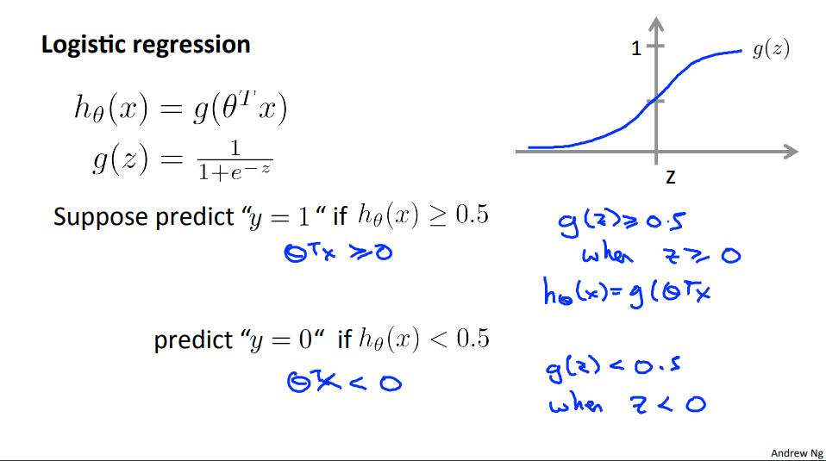

Slide 17
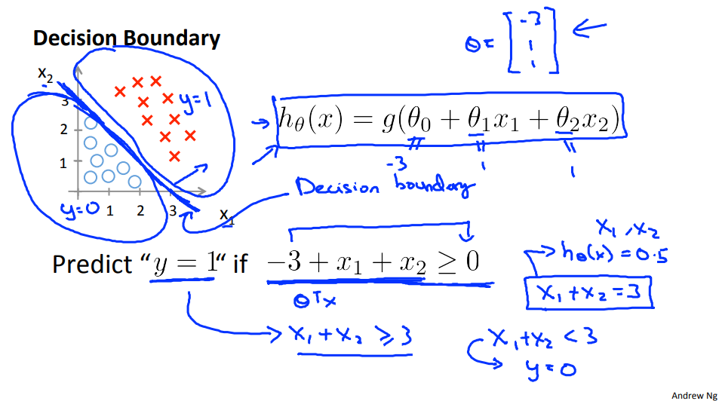

Slide 18
PRACTICAL EXERCISES

Slide 19
Other Supervised Learning Algorithms

Slide 20
Other algorithms/techniques
Typically when trying to create a predictive AI, we train multiple different models and see which ones perform best on the data.
In this lesson, we will look at other models for both classification and regression tasks.
We will look at decision tree, random forest, support vector and nearest neighbor algorithms.
Each of these algorithms have variants for regression and classification tasks.
E.g. There is a Random Forest Classifier and a Random Forest Regressor.

Slide 21
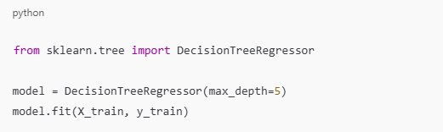
Other algorithms/techniques
Decision Tree Regression
Best for non-linear relationships as it captures interactions between features
It splits data into branches based on feature values
Pro: It can handle both numerical and categorical features. It is also interpretable
Con: Can overfit if not pruned (max_depth in sklearn)

Slide 22
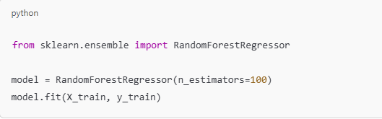
Other algorithms/techniques
Random Forest Regression
Best for complex, non-linear problems requiring high accuracy
It uses multiple decision trees and averages the predictions
Pro: It reduces overfitting and performs well on various datasets
Con: Computationally expensive for large datasets

Slide 23
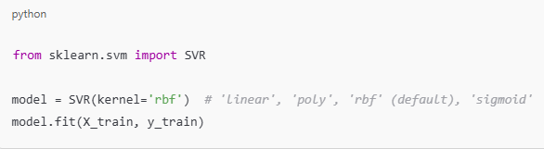
Other algorithms/techniques
Support Vector Regression (SVR)
Best for regression with small to medium datasets and non-linear relationships.
It uses support vectors and kernels to find the best fit
Pro: Works well even with outliers and is robust to overfitting
Con: Computationally expensive, sensitive to hyperparameters

Slide 24
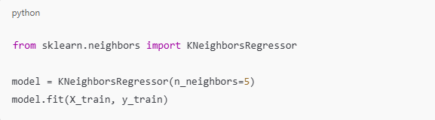
Other algorithms/techniques
k-Nearest Neighbors Regression (SVR)
Best for when there’s no clear mathematical relationship between input and output.
Predicts based on the average of k-nearest neighbors
Pro: Simple, no parameters
Con: Requires tuning k, slow for large datasets

Slide 25
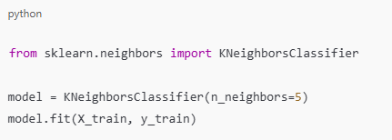
Other algorithms/techniques
For classification tasks, the code still remains the same but we import slightly different models.
Instead of importing the Regressor, we will import the Classifier. Take the example of the image below for KNeighborsRegressor
Regression
Classification

Slide 26
Practical exercise 2
Training and comparing multiple ML models

Slide 27
Practical exercise 2
This exercise is to be done in the same notebook as the previous exercise
We are building upon what we started. This time we are going to train multiple models and compare their accuracies.
We are going to do this for the regression task (phone price prediction). We want to compare the accuracies of the following models
Linear regression
Decision tree
Random forest
Support Vector
K Nearest Neighbors
Follow the instructions given by the instructor.

